Slide 1

F.I.D.O
Feces Identification and Detection Using Optics
Team: Jake Borham, Will Nichols, Miles Olson, Brock Bye, Zach Jacobs
Advisor: Andrew Lamperski
Senior Product Launch Presentation
4/25/2025

Slide 2
The Big Picture
Millions of dog owners in the U.S.
Front/Back yards, Public parks, trails, and more places are plagued by uncollected waste
Health concerns: bacteria, parasites, water contamination
People send thousands of hours trying to pick up waste, yet miss hidden waste
F.I.D.O exists to help solve a gross and persistent hygiene problem.

Slide 3
What is F.I.D.O
A small, wired, wifi enabled detection system that uses thermal imaging and computer vision to locate and mark hidden dog waste even in grass, snow, or low-light environments.
Powered by Raspberry Pi + thermal camera
Displays heat-based detections to users
Interactive GUI to mark/clear objects

Slide 4
Who Will Use It & Why They’ll Love It
Dog owners: avoid awkward surprises
Park maintenance crews: faster cleanup, better sanitation
City governments: fewer complaints, less cost
Animal care professionals: potential applications for thermal-based detection

Slide 5
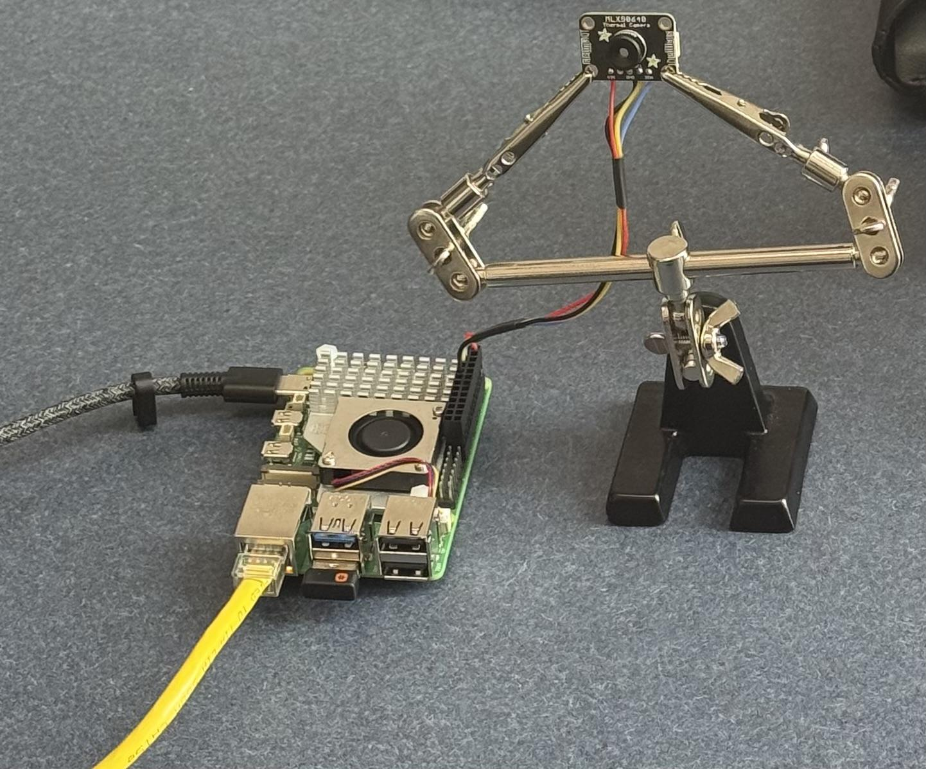
How We Built It
Identified problem scope and use case
Selected thermal imaging hardware
Developed image processing pipeline
Built custom graphical interface
Checked performance

Slide 6

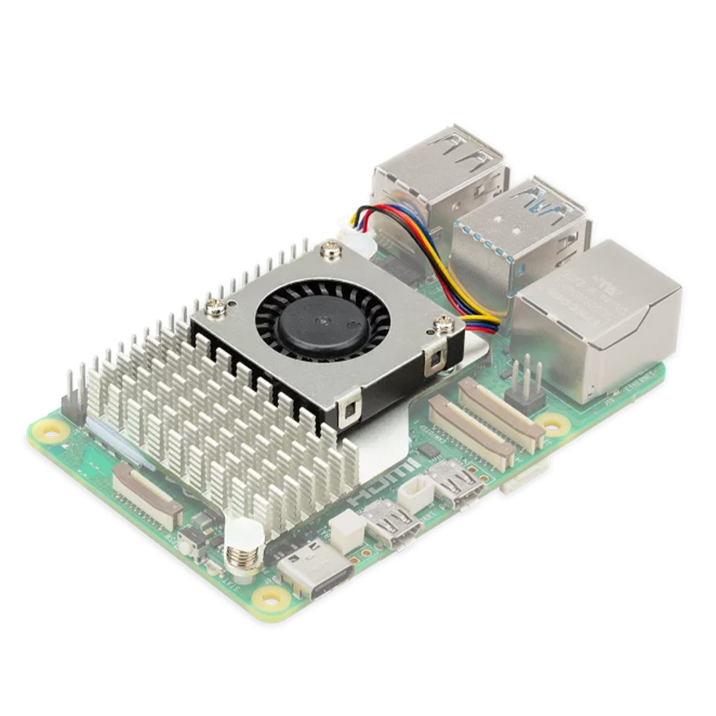
Hardware
Raspberry Pi 5
I2C - To communicate with our thermal camera
Self Sufficient - Perform computations internally
WIFI - Wireless connectivity for standalone operation
Python Friendly - Support python libraries
Computational Power - Support CV and external UI display

Slide 7
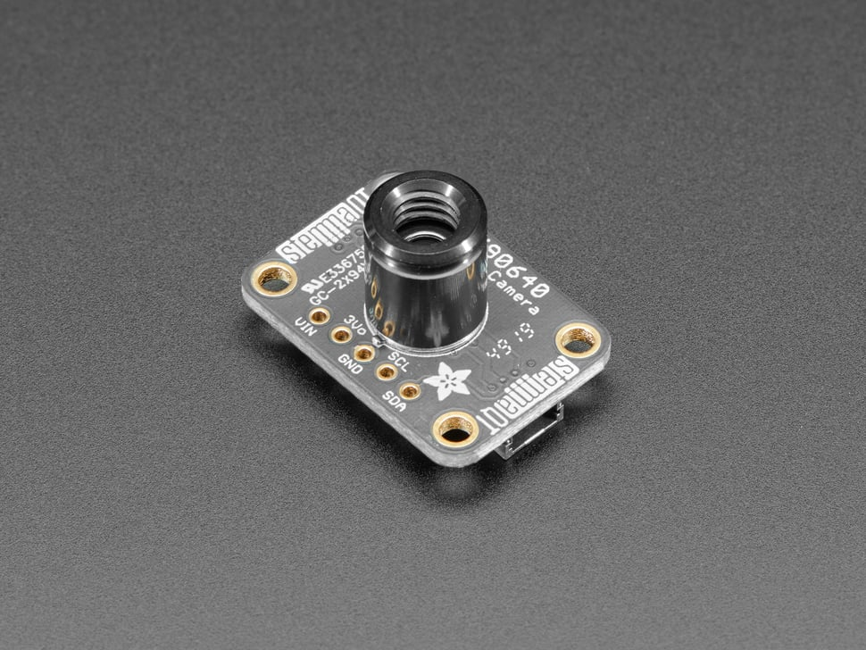
Thermal Camera
MLX90640:
24×32 pixel thermal resolution
16 FPS capture
Detects temperature gradients
Ideal for detecting warm decay in feces
Challenges:
Adjusting for ambient temperatures
Tuning detection thresholds

Slide 8

Data Pipeline
Receive thermal Data Stream
Upscale data to higher-resolution Image
Apply color mapping
32x24
320x240

Slide 9
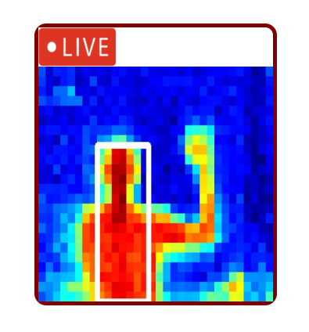
Object detection
Apply thresholding
Detect contours
Filter out noise

Slide 10
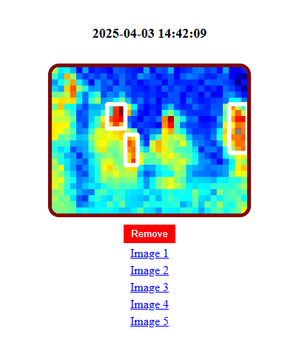
Track static objects
Detect object center coordinates
Track object movement across frames
Log and store objects that remain stationary

Slide 11
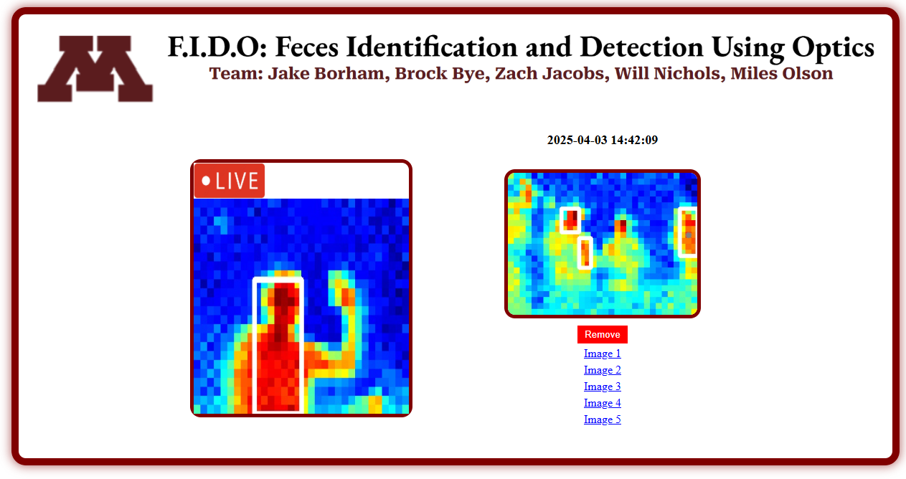
Graphical interface (GUI)
Interactive web application built with Flask and JavaScript
Live thermal feed displaying real-time object detection
Clickable list of detected static objects with direct image references

Slide 12
Acceptance Test
Detects heat-emitting objects within close range (3 meters)
Detection data transmits to external system (Raspberry Pi, User interface)
Meets reliability standards (Continuous operation, Minimal latency 1 dropped frame per 5 sec)
Aligns with outlined form, fit, and function criteria
Compact and stationary
Minimal maintenance
Housed as one device

Slide 13
Challenges We Overcame
Remote configuration and debugging of the Raspberry Pi environment
Dealing with ambient temperature fluctuations affecting detection accuracy
Performance limitations due to slow Python-based interpolation
Server-side integration and backend implementation complexities
Designing an intuitive and responsive web interface

Slide 14
Timeline and Development Milestones
Date Completed
February 7th
February 21st
February 26th
March 6th
March 19th
March 27th
April 10th
May 2nd
Milestones
Milestone 1 - Selected appropriate infrared camera and computing platform
Milestone 2 - Integrated camera with compute module and completed functional testing
Milestone 3 - Converted raw thermal data into usable visual formats
Milestone 4 - Applied and optimized computer vision techniques for object detection
Milestone 5 - Established communication pipeline with external user interface
Milestone 6 - Designed and deployed a responsive, user-friendly GUI
Milestone 7 - Conducted comprehensive system testing in controlled environments
Milestone 8 - Developed thorough documentation to support future iterations

Slide 15
The Future of F.I.D.O
F.I.D.O is a platform — not just a tool.
Possible Upgrades:
Upgrade to higher-resolution thermal imaging for improved accuracy
Develop mobile app for remote access and user interaction
Implement real-time alert and notification system
Incorporate spatial localization for precise object mapping
Pursue commercial partnerships with municipalities and public parks

Slide 16

Questions?

